Slide 1

G2M Case Study
Virtual Internship
20-Jun-2022

Slide 2
Background –G2M(cab industry) case study
XYZ is a private equity firm in US. Due to remarkable growth in the Cab Industry in last few years and multiple key players in the market, it is planning for an investment in Cab industry.
Objective : Provide actionable insights to help XYZ firm in identifying the right company for making investment.
The exploratory data analysis has been divided into three parts:
Data Understanding and Processing
Data Analysis
EDA Summary

Slide 3
Data Understanding
After viewing and understanding the data filed names we can find that we have common field names such as:
Transaction ID > common between Cab_Data & Transaction_ID datasets
Customer ID > common between Customer_ID & Transaction_ID datasets
As a result we merge these data based on the common field variables and discover the dataset types
12 features
Total data points : 359,392
We can learn from the categorical variables the following,
Operating companies: ATLANTA GA and Yellow Cab
Payment Methods: Card and Cash
Trip services across: 19 cities
No. of Customers served: ~ 45,000

Slide 4
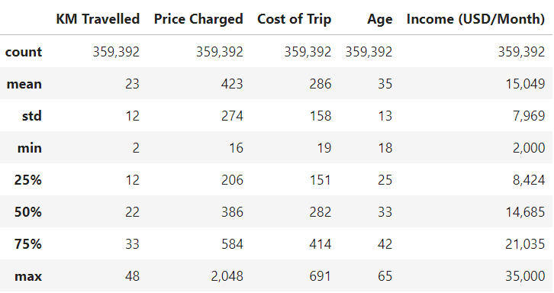
Data Understanding
Statistics of numerical features:

Slide 5
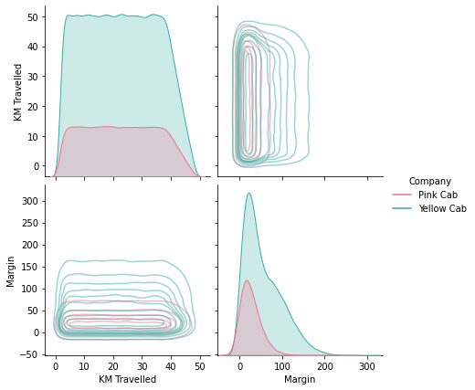
Profit Analysis
Data Analysis – Profit Margin Distribution

Slide 6
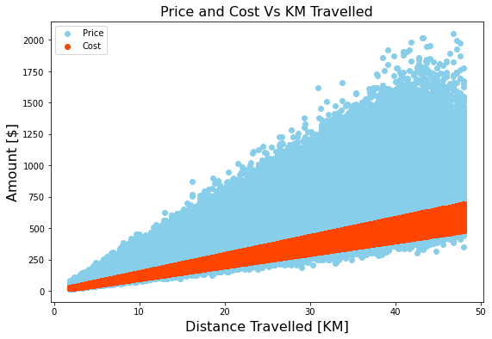
Profit Analysis
Data Analysis – Price and Cost Vs. KM Travelled

Slide 7
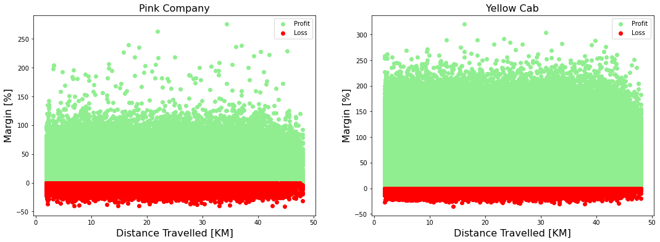
Profit Analysis
Profit Margin Analysis

Slide 8
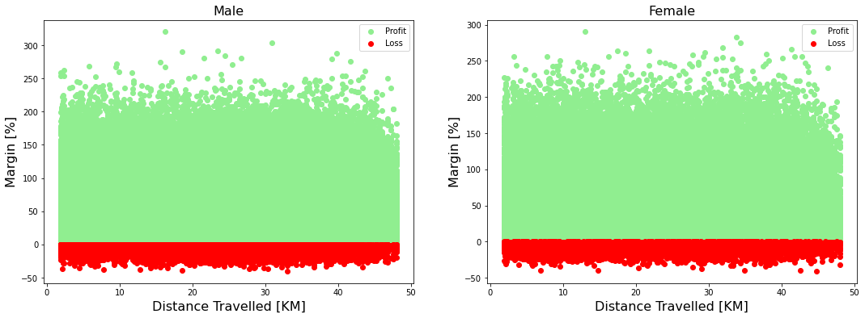
Profit Analysis
Profit Margin Analysis

Slide 9
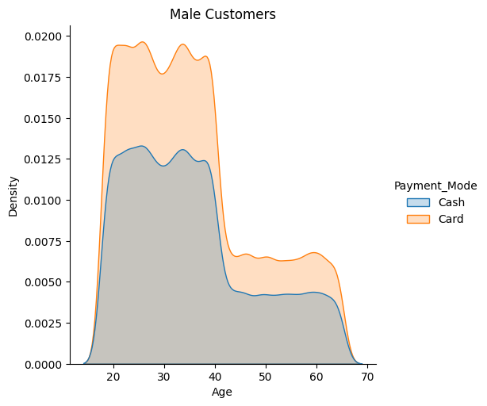
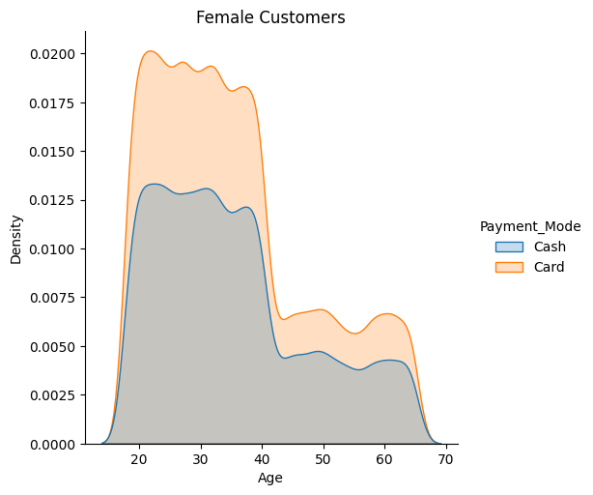
Age Analysis

Slide 10
EDA Summary
The yellow cab company can achieve higher margins than the pink cab company.
The yellow cab company has significantly provided more trips that the pink cab company. We could observe that by serving more customers the margins achieved can be increased.
We could observe that among both cab companies the margin distribution is uniform to a great extent along the travelled distance domain, where the yellow cab company can achieve higher profit margins and less loss margins that the Pink Company.
We could find that the margins are equally spread between males and females and therefore both genders contribute proportionally in equal terms towards the margin creation.
We could find that for both genders males and females, we have youth customers (< 40 years old) are more than double the number of old customers (> 40 years old)
We could observe that almost all customers tend to use payment cards more than using cash with an approximate factor of 1.5. This observation is consistent among both genders and across the whole age span.

Slide 11
Thank You

